Slide 1
Appendix D
MATLAB’s GUI Tools Tutorial

Slide 2
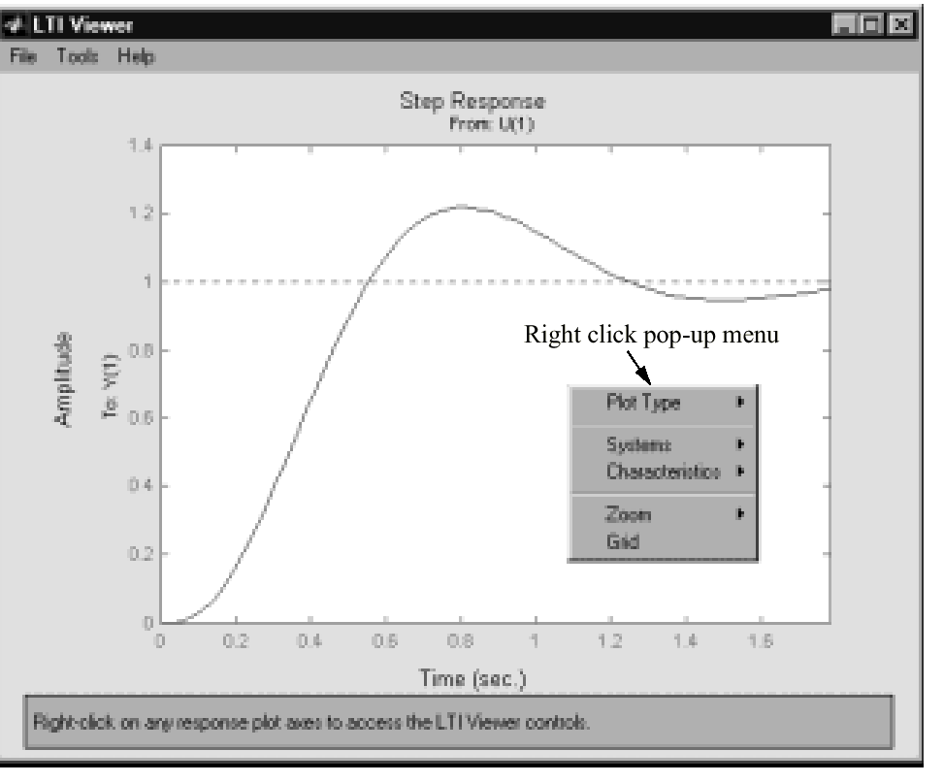
Figure D.1
LTI Viewer showing
right click pop-up
menu

Slide 3
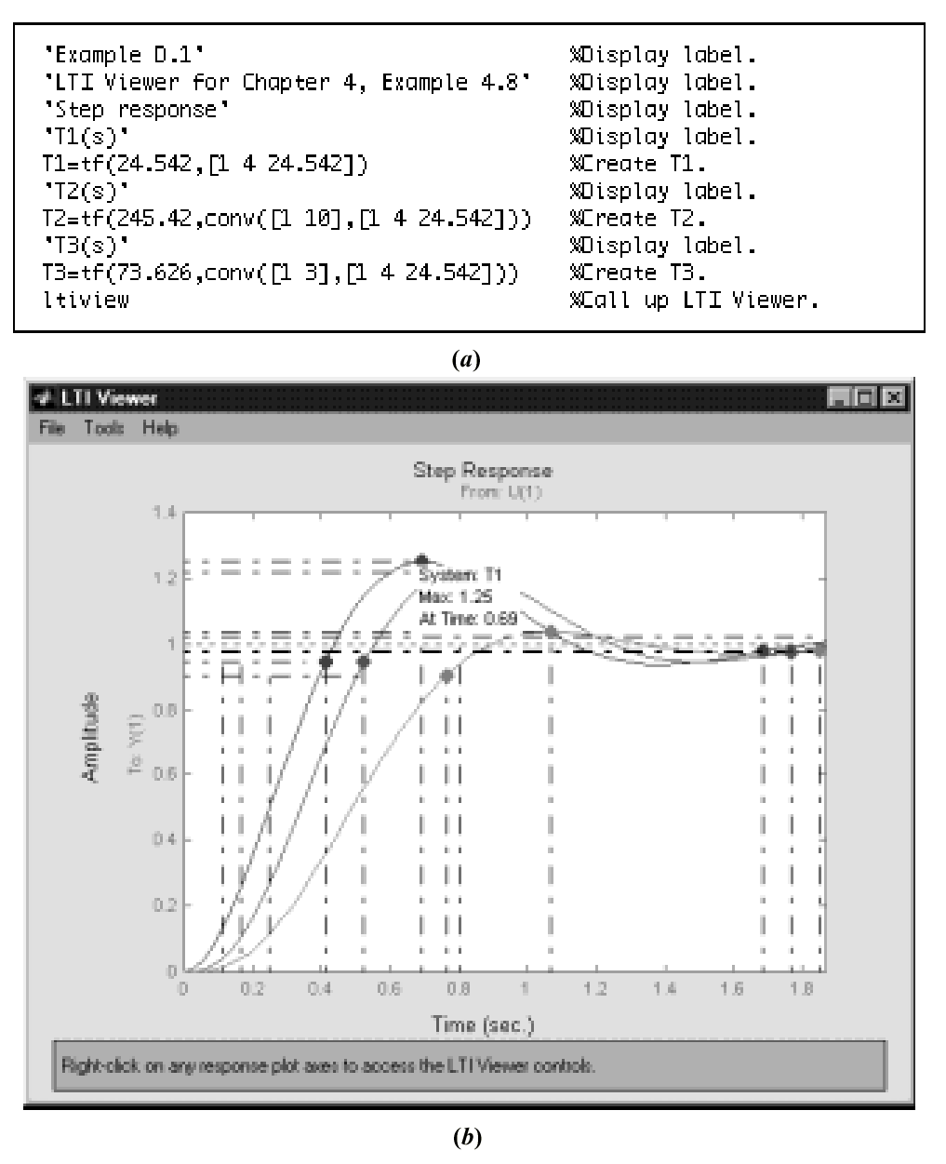
Figure D.2
LTI Viewer used for
step response:
a. M-file;
b. LTI Viewer

Slide 4
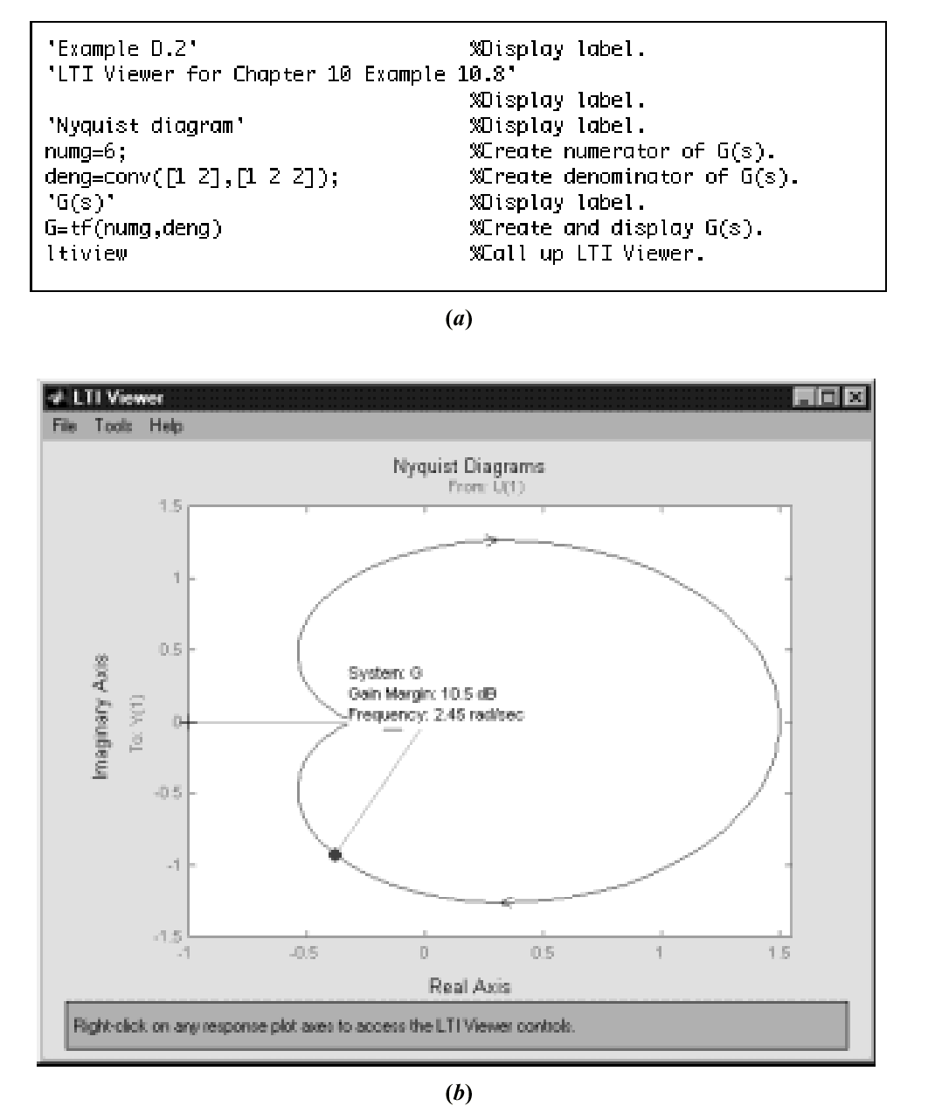
Figure D.3
LTI Viewer used for
Nyquist diagram:
a. M-file;
b. LTI Viewer

Slide 5
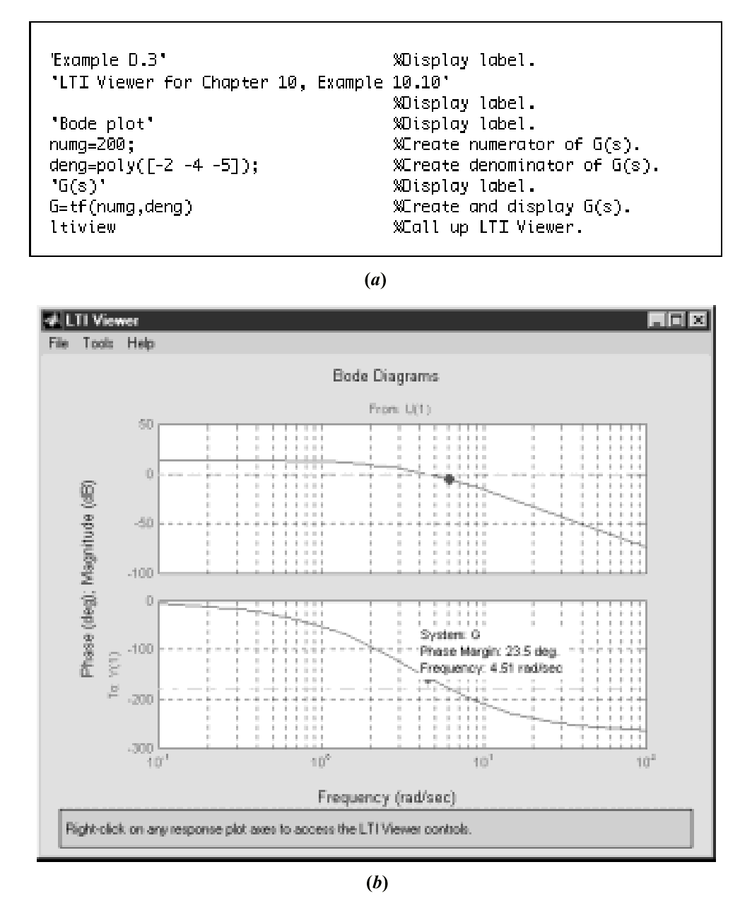
Figure D.4
Figure D.4 LTI Viewer
used for Bode plot:
a. M-file;
b. LTI Viewer

Slide 6
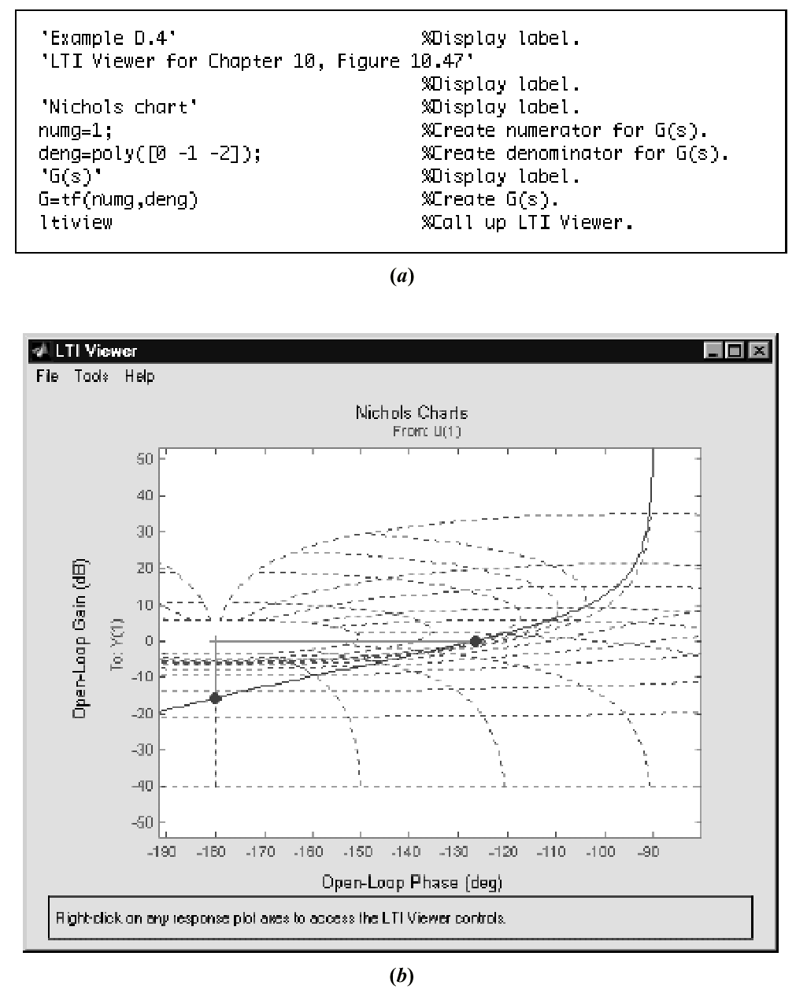
Figure D.5
Figure D.5 LTI Viewer
used for Nichols chart:
a. M-file;
b. LTI Viewer

Slide 7
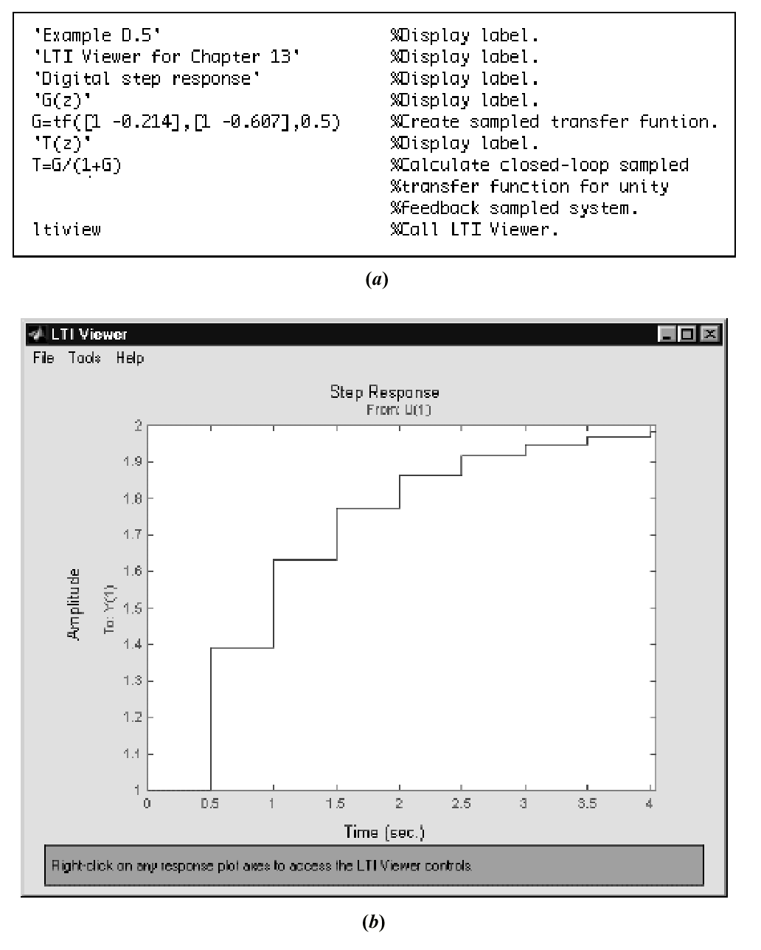
Figure D.6
Figure D.6 LTI Viewer
used for digital step
response:
a. M-file;
b.LTI Viewer

Slide 8
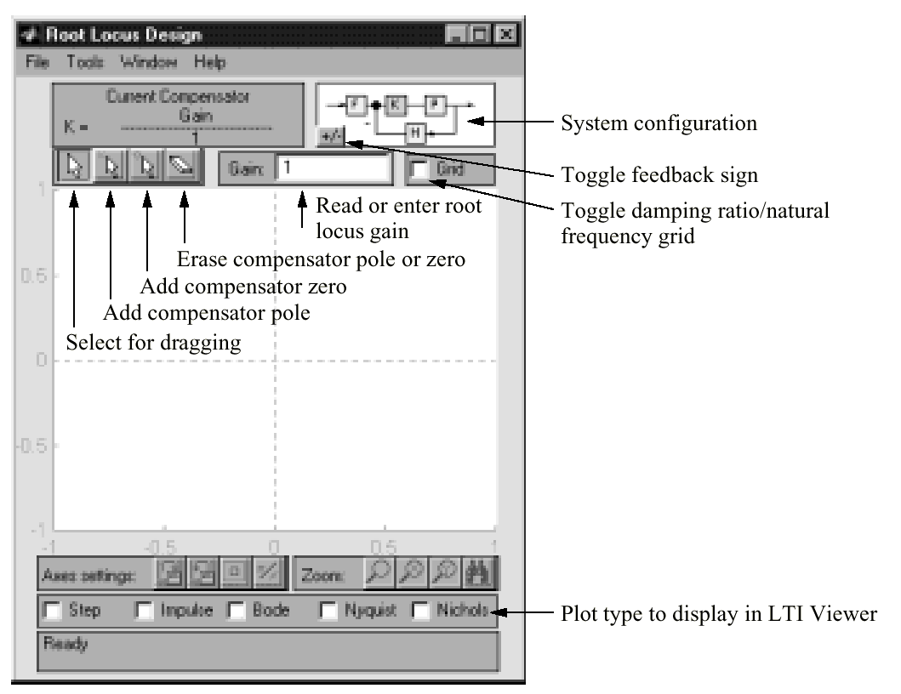
Figure D.7
Root Locus Design
window

Slide 9
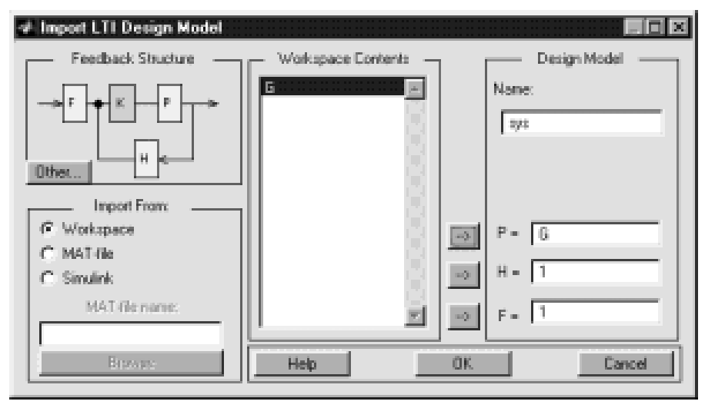
Figure D.8
The Import LTI
Design Model
window showing
G selected as
the plant, P

Slide 10
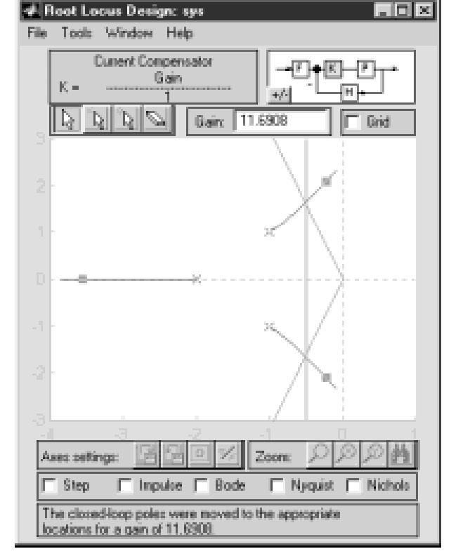
Figure D.9
Root Locus Design
window for the
created system with
the closed-loop pole in
the second quadrant
selected

Slide 11
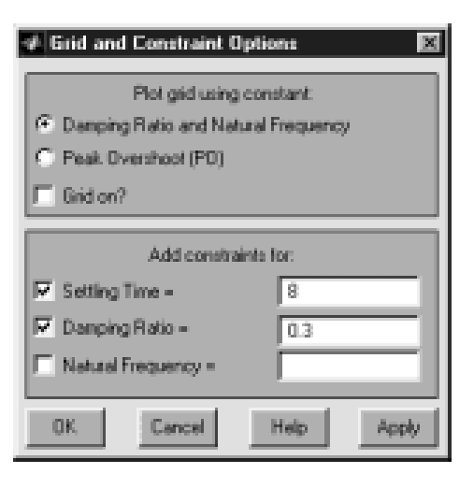
Figure D.10
Grid and Constraint
Options window with
boundaries for eight
seconds settling time
and 0.3 damping ratio

